Slide 1
CS422 Database systems
Query Processing
Data-Intensive Applications and Systems (DIAS) Laboratory École Polytechnique Fédérale de Lausanne
“If we have data, let’s look at data. If all we have are opinions, let’s go with mine” – Jim Barksdale
Some slides adapted from:
Andy Pavlo
CS-322

Slide 2

(Simplified) DBMS Architecture
Application Front Ends
Web Forms
SQL Interface
Memory
SQL Commands
Parser + Optimizer +
Plan Execution
Transaction
Manager
Recovery
Manager
Files and Access Methods
Buffer Management
Storage Management
Disk
Data

Slide 3
Zoom in
Query Optimizer
Cost Estimates
Abstract Syntax Tree
Logical Query Plan
Physical Query Plan
(Cost-based) Optimizer
Plan Executor
Parser
Planner
How the DBMS executes a query (plan)

Slide 4
Query Plan
Operators are arranged in a tree.
Data flows from leaves to root.
Output of root = Query result.

Slide 5
Processing model
The processing model of a DBMS defines how the system executes a query plan.
Different trade-offs for different workloads
Extreme I: Tuple-at-a-time via the iterator model
Extreme II: Block-oriented model (typically column-at-a-time)

Slide 6
Iterator Model
Each query plan operator implements a next function.
On each invocation, the operator returns either a single tuple or a null marker if there are no more tuples.
The operator implements a loop that calls next on its children to retrieve their tuples and then process t
Top-down plan processing. Also called Volcano or Pipeline model.
Most popular method for (disk-oriented) DBMS
Notes:
15721 -> spring2016 -> 02.pdf (1-2 slides)
Main: fall2017/slides/10-queryprocessing.pdf

Slide 7





Iterator Model
Used in almost every DBMS
Allows for tuple pipelining
Some operators will block until children emit all of their tuples.
Output control works easily
LIMIT operator

Slide 8
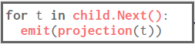
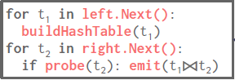
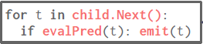
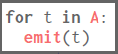
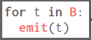
Iterator Model

Slide 9
Iterator Model
1
2
4
3
5

Slide 10
(Interpreted) Expression Evaluation
The DBMS represents a WHERE clause as an expression tree. Nodes in the tree represent different expression types:
Comparisons (=, <, >, !=)
Conjunction (AND), Disjunction (OR)
Arithmetic Operators (+,-,*,/,%)
Constant Values
Tuple Attribute References
AND
=
>
Attribute(A.id)
Attribute(A.id)
Attribute(val)
Constant(100)

Slide 11
Expression Evaluation
SELECT * FROM B
WHERE B.val = ? + 1
Execution Context
Current Tuple (123, 1000)
Query Parameters (int:999)
Table Schema B(int:id, int:val)
=
The DBMS traverses the tree. For each node that it visits, it has to figure out what the operator needs to do.
This happens for every… single… tuple…
Even for SELECT * FROM B WHERE 1 = 1
It is SLOW
true
Attribute(val)
+
1000
1000
Parameter(0)
Constant(1)
999
1
Notes:
And too many function calls per tuple. Function calls ARE EXPENSIVE.

Slide 12
Interpreted, tuple-at-a-time processing
Many function calls
Save/restore contents of CPU registers
Force new instruction stream in the pipeline → bad for instruction cache
Generic code
Has to cover every table, datatype, query
1
2
4
3
5

Slide 13
More complex queries, more problems
Each getNext will invoke the getNext of child operator
Many function calls for each tuple
Many context switches
Generic operators implementation: lot of code for type-checking & casting
⨝
⨝
Γ
σ
σ
B
C
A

Slide 14
Processing model
The processing model of a DBMS defines how the system executes a query plan.
Different trade-offs for different workloads
Extreme I: Tuple-at-a-time via the iterator model
Extreme II: Block-oriented model (typically column-at-a-time)

Slide 15
Block-oriented (aka materialization) model
Each operator processes its input all at once and emits its output all at once
The operator “materializes” its output as a single result.
Bottom-up plan processing.

Slide 16
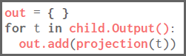
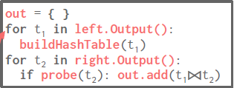
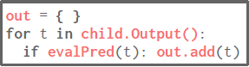
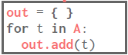
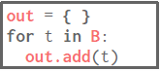
Block-oriented Model
5
4
3
2
1

Slide 17
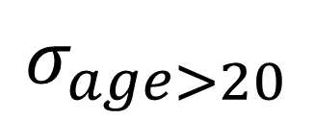

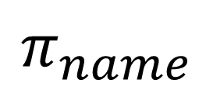
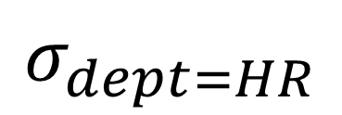
The (output) materialization problem – Naïve version
tbl
tid
1
Name
John
$$π_{name}$$
tid
1
2
3
Name
John
Jack
Jane
Age
22
19
37
Dept
HR
HR
IT
tid
1
$$⋈$$
SELECT Name FROM tbl
WHERE Age > 20
AND Dept = “HR”
tid
1
3
Age
22
37
$$σ_{age>20}$$
$$σ_{dept=HR}$$
tid
1
2
Dept
HR
HR
tbl

Slide 18
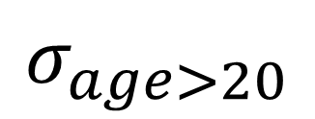
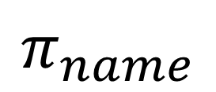
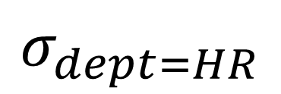
The (output) materialization problem – version 2
tbl
tid
1
Name
John
$$π_{name}$$
tid
1
2
3
Name
John
Jack
Jane
Age
22
19
37
Dept
HR
HR
IT
tid
1
$$σ_{dept=HR}$$
SELECT Name FROM tbl
WHERE Age > 20
AND Dept = “HR”
tid as extra filter to reduce output! Can we reduce it even more?
tid
1
3
$$σ_{age>20}$$
tbl

Slide 19
The (output) materialization problem – selection vector
SELECT Name FROM tbl
WHERE Age > 20
AND Dept = “HR”
$$π_{name}$$
Name
John
bitmap
1
0
0
Only materialize bitmap
Perform calculations only for relevant tuples
$$σ_{dept=HR}$$
tbl
tid
1
2
3
Name
John
Jack
Jane
Age
22
19
37
Dept
HR
HR
IT
bitmap
1
0
1
$$σ_{age>20}$$
tbl

Slide 20

The (tuple) materialization problem
When joining tables, columns can get shuffled => Cannot use virtual ids => Stitching causes random accesses
tbl1.age
tid | Name
1 | John
3 | Jane
2 | Jack
tid | Age
1 | 22
2 | 19
3 | 37
$⋈$
tbl2.name=tbl1.name
tbl2
tbl1
The order of tbl1.name entries can change after the join!!!
Option: Stitch columns before join
Option: Sort list of tids before projection
Option: Use order-preserving join algorithm (Not always applicable)

Slide 21

Block-oriented model
No next() calls -> no per-tuple overhead
Typically combined with columnar storage
Cache-friendly
SIMD-friendly
“Run same operation over consecutive data”
Avoid interpretation when evaluating expressions (in most cases)
Typically use macros to produce 1000s of micro-operators (!!!)
selection_gt_int32(int *in, int pred, int *out)
selection_lt_int32(int *in, int pred, int *out)
…
Output materialization is costly (in terms of memory bandwidth)

Slide 22
So far: The two extremes
Tuple-at-a-time execution
Column-at-a-time execution

Slide 23


Slide 24
The beer analogy (by Marcin Zukowski): How to get 100 beers
Tuple-at-a-time execution:
Go to the store
Pick a beer bottle
Pay at register
Walk Home
Put beer at bridge
Repeat till you have 100 beers
Many unnecessary steps
Column-at-a-time execution
Go to the store
Take 100 beers
Pay at register
Walk Home
100 beers not easy to carry

Slide 25
The middle ground: Vectorization model
Like iterator model, each operator implements a next function
Each operator emit a vector of tuples instead of a single tuple
Vector-at-a-time, aka “Carry a crate of beers at a time”!
The operator’s internal loop processes multiple tuples at a time.
Vector size varies based on hardware or query properties
General idea: Vector must fit in CPU cache

Slide 26
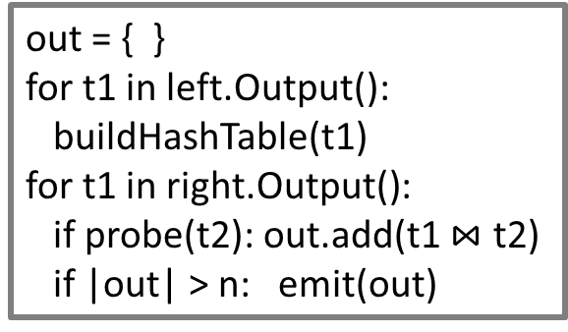
Vectorization model
1
out = { }
for t in child.Output():
out.add(projection(t))
if |out| > n: emit(out)
out = { }
for t1 in left.Output():
buildHashTable(t1)
for t1 in right.Output():
if probe(t2): out.add(t1 $⋈$ t2)
if |out| > n: emit(out)
2
4
out = { }
for t1 in child.Output():
if evalPred(t): out.add(t)
if |out| > n: emit(out)
out = { }
for t in A:
out.add(t)
if |out| > n: emit(out)
out = { }
for t in B:
out.add(t)
if |out| > n: emit(out)
5
3
Notes:
out = { }
for t in child.Output():
out.add(projection(t))
if |out| > n: emit(out)

Slide 27

Vectorization model
Ideal for OLAP queries
Greatly reduces the number of invocations per operator
Allows for operators to use vectorized (SIMD) instructions to process batches of tuples

Slide 28
Execution of the physical plan
Two approaches
Traditional approach: interpretation
Code generation & compilation

Slide 29
Processing model
The processing model of a DBMS defines how the system executes a query plan.
Different trade-offs for different workloads
Extreme I: Tuple-at-a-time via the iterator model
Query compilation
Vectorization model
Extreme II: Block-oriented model (typically column-at-a-time)

Slide 30
Remark from Microsoft Hekaton
After switching to an in-memory DBMS, the only way to increase throughput is to reduce the number of instructions executed.
To go 10x faster, the DBMS must execute 90% fewer instructions
To go 100x faster, the DBMS must execute 99% fewer instruction
The only way to achieve such a reduction in the number of instructions is through code specialization.
Generate code that is specific to a particular task in the DBMS.
(Currently, most code is written to be understandable)

Slide 31
Move from general to specialized code
Any CPU intensive entity of a database can be natively compiled if they have a similar execution pattern on different inputs
Access Methods
Operator Execution
Predicate Evaluation
Goal: Avoid runtime decisions! Decide once, when you see the query plan!

Slide 32
What do we know from the query plan?
Attribute types
=> (Inline) pointer casting instead of data access (virtual) function calls
Query predicate types
=> Can use primitive data comparisons
“Hard-code” this knowledge into the execution engine

Slide 33
MySQL performance breakdown
SELECT l_returnflag, l_linestatus,
sum(l_quantity) AS sum_qty,
sum(l_extendedprice)
AS sum_base_price,
sum(l_extendedprice *
(1 - l_discount)) AS sum_disc_price,
sum(l_extendedprice *
(1 - l_discount) * (1 + l_tax))
AS sum_charge,
avg(l_quantity) AS avg_qty,
avg(l_extendedprice) AS avg_price,
avg(l_discount) AS avg_disc,
count(*) AS count_order
FROM lineitem
WHERE l_shipdate <= date '1998-09-02'
GROUP BY l_returnflag, l_linestatus
[Locking + Buffer Allocation costs minimal]

Slide 34

Query Compiler
Query Optimizer
Logical Query Plan
Physical Query Plan
AST
Plan Rewriter
Plan Optimizer
Parser
Code Generator
Native Code

Slide 35
Two approaches for code generation
Transpilation
DBMS converts a relational query plan into C/C++ code
Compile the produced code to generate native
JIT compilation
Generate an intermediate representation (IR) of the query that can be quickly compiled into native code.

Slide 36
Transpilation use case: The HIQUE system
HIQUE: Holistic Integrated QUery Engine
For a given query plan, create a C program that implements that query’s execution. → Bake in all the predicates and type conversions.
Use an off-shelf compiler to convert the code into a shared object, link it to the DBMS process, and then invoke the exec function.

Slide 37
Operator templates
SELECT * FROM A WHERE A.val = ? + 1
Known at query
compile time
Interpreted plan
Templated plan
for t in range(table.num_tuples): tuple = get_tuple(table, t) if eval(predicate, tuple, params):
emit(tuple)
tuple_size = ### predicate_offset = ### parameter_value = ###
for t in range(table.num_tuples): tuple = table.data + t ∗ tuple_size
val = (tuple+predicate_offset)
if (val == parameter_value + 1):
emit(tuple)
Get schema in catalog for table
Calculate offset based on tuple size
Return pointer to tuple
Traverse predicate tree and pull values up
For tuple values, calculate the offset of the target attribute
Resolve datatype (switch / virtual call)
Return true/false

Slide 38
Operator templates
Similar benefits for all other operators
SELECT * FROM A WHERE A.val = ? + 1
Interpreted plan
Templated plan
for t in range(table.num_tuples): tuple = get_tuple(table, t) if eval(predicate, tuple, params):
emit(tuple)
tuple_size = ### predicate_offset = ### parameter_value = ###
for t in range(table.num_tuples): tuple = table.data + t ∗ tuple_size
val = (tuple+predicate_offset)
if (val == parameter_value + 1):
emit(tuple)
Get schema in catalog for table
Calculate offset based on tuple size
Return pointer to tuple
Traverse predicate tree and pull values up
For tuple values, calculate the offset of the target attribute
Perform casting
Return true/false
Predicate evaluation becomes a single line!

Slide 39
Integrating with the rest of the DBMS
The generated query code can invoke any other function in the DBMS → no need to generate code for the whole DB!
Re-use the same components as interpreted queries.
Concurrency control
Logging and checkpoints
Indexes

Slide 40
Indicative Performance
Up to 2 orders of magnitude improvement compared to
interpreted DBs
(PostgreSQL)
Notes:
PostgreSQL is traditional interpreter-based db
System X is commercial db (called system x for anonymity).

Slide 41
The catch
Compilation takes time!
In practice, ~1 second is not a big issue for OLAP queries
An OLAP query may take tens to hundreds of seconds
How about OLTP queries?
Hint: In OLTP, we know the typical queries → pre-compile and cache

Slide 42
HIQUE take-home message
Reduce function calls
Specialized code → avoid casting & type-checking, smaller code, promote cache reuse
BUT
Compilation takes time
How about complex plans?
Sticks to the operator “legacy” abstraction

Slide 43
JIT compilation: The HyPer approach
Generate code using LLVM
LLVM: Collection of modular and reusable compiler and toolchain technologies.
Core component is a low-level programming language (IR) that is similar to assembly.
Not all of the DBMS components need to be written in LLVM IR. → LLVM code can make calls to C++ code.
HyPer goal: “Keep a tuple in CPU registers as long as possible”
Push data through execution plan
Blur operator boundaries

Slide 44
LLVM example: input and output
int mul_add(int x, int y, int z) {
return x * y + z;
}
define i32 @mul_add(i32 %x, i32 %y, i32 %z) {
entry:
%tmp = mul i32 %x, %y
%tmp2 = add i32 %tmp, %z
ret i32 %tmp2
}
Produced code very close to assembly
Compilation very fast (tens of milliseconds!)

Slide 45
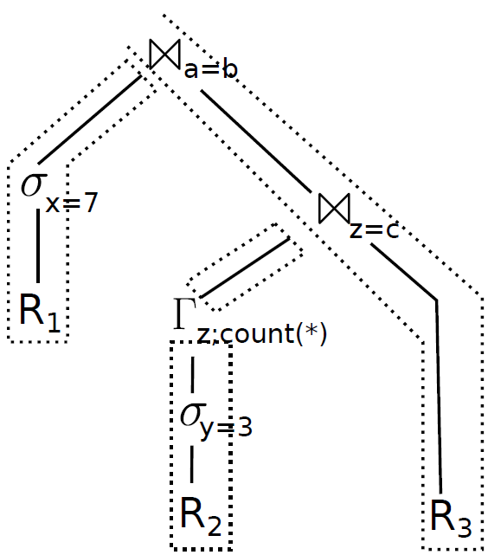
Push-based model for query compilation
Data pushed up the pipeline
Materializing only at pipeline breakers
No function calls in loops => Compiler distributes data to registers and increases cache reuse.
Execute without “spilling data to memory”
Notes:
The way this concept is manifested is by using a push – based model.
The tuple currently processed is loaded into CPU registers,
All pipelining ancestor operators are applied,
And the tuple is materialized into the next pipeline breaker (e.g. hash join sides). Pipeline breaker is any operator causing data to be materialized, spilled in memory in our case, such as an aggregate
operator, or a hash-join requiring a hashtable to be built.
The efficient implementation of such a model requires having code applied to register-based data.
In order to achieve such a fine-grained control of execution, the authors apply code generation techniques, relying on compiler infrastructure to dictate which values
are placed in registers.
----------------------------------------------------------------------------------------------------------------------
Pipeline breaker: they cause values to be evicted from registers and “spilled to memory. Don’t allow pipelining
How to get all this fine grained control? How not to have a function call ruining everything?
“Hot Path of execution”
The complex part of the query processing (e.g., complex data structure management or spilling to disk) is written in C++, and forms the cogwheels
Generate code to handle tuple processing
Complex code pieces unchanged
-------------------------------------------------

Slide 46
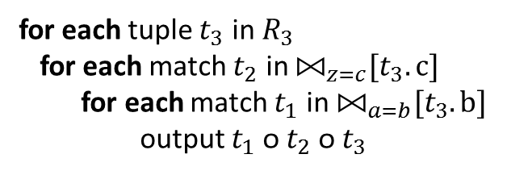
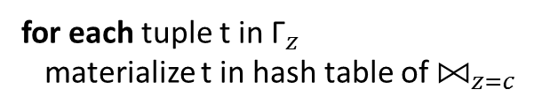
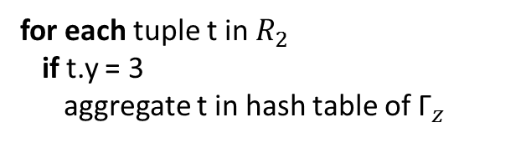
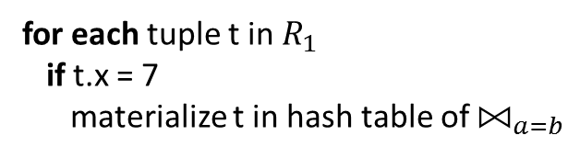
Generate code for plan
for each tuple t in $R_{1}$
if t.x = 7
materialize t in hash table of ${\text{⨝}}_{a=b}$
for each tuple t in $R_{2}$
if t.y = 3
aggregate t in hash table of ${\text{Γ}}_{z}$
for each tuple t in${ \text{Γ}}_{z}$
materialize t in hash table of ${\text{⨝}}_{z=c}$
for each tuple $t_{3}$ in$R_{3}$
for each match $t_{2}$ in ${\text{⨝}}_{z=c}[t_{3}.c]$
for each match $t_{1}$ in ${\text{⨝}}_{a=b}[t_{3}.b]$
output $t_{1} \text{ᴏ}{ t}_{2} \text{ᴏ} t_{3}$
Operator boundaries blurred – Imperative execution

Slide 47
The Catch
select d_tax from warehouse, district where w_id=d_w_id and w_zip='…'

Slide 48
(more)
select d_tax from warehouse, district where w_id=d_w_id and w_zip='…'
Low-level, error-prone coding

Slide 49
Query compilation
Pipelined query processing without interpretation cost
Very painful to implement
BUT: Benefits have led major DBMS (and Spark!) to implement it

Slide 50
Conclusion
The processing model of a DBMS defines how the system executes a query plan.
Tuple-at-a-time via the iterator model
Query compilation
Vectorization model
Block-oriented model (typically column-at-a-time)
Hybrids do exist!!!

Slide 51
Backup Slides

Slide 52
Compilation cost
Notes:
Comparison not 100% fair, different hardware. But difference of 1 order of magnitude is huge, and not attributed to different hardware that is comparable. It is attributed to lower complexity!

Slide 53
Volcano iterator model
$$Γ_{sum}$$
r1
next()
Pull-based Interface: open/next/close
Tuple-at-a-time processing
Each operator produces a tuple stream
$$π$$
r1
next()
$$σ$$
r1
next()
$$Scan$$
r1
next()
R
Simple interface, pipelined execution
Notes:
The traditional method is the Volcano iterator model.
In the Volcano iterator model, the query is rewritten into a tree of operators representing actions such as selections, projections, and joins.
Every operator exposes the same pull-based interface, consisting of an open, next and close function call of an iterator.
When an operator issues a next call, it is forwarded to its children nodes, which again call next, and it results in a tuple being produced and returned upwards to the operator originally requesting it.
During query evaluation, each operator will therefore end up producing a tuple stream.
To sum up, Volcano offers a simple, intuitive interface, which also enables pipelined execution, in the sense that produced tuples from one operator can be generally be passed to the
parent operators without copying in another place in memory.
---------------------------------------------------------
* pipelining
pull-based
The time it takes to call a virtual member function is a few clock cycles more than it takes to call a non-virtual member function, provided that the function call statement always calls the same version of the virtual function. If the version changes then you will get a misprediction penalty of 10 - 30 clock cycles. The rules for prediction and misprediction of virtual function calls is the same as for switch statements...

Slide 54
Volcano CPU costs
[Graefe]
Control flow constantly changing
Many (virtual) function calls
Branch mispredictions
“Real Work” a fraction of total execution
Notes:
However, the very abstractions that make the Volcano iterator model so simple also penalize its performance..
As multiple function calls are needed per each tuple handled by an operator, this results in a very large number of function calls.
These function calls also lead to branch mispredictions, as they are either typically either virtual or made through a function pointer.
In addition, the fact that the control flow is constantly changing leads to poor code locality.
The result of all these is that the real work that needed to be done to evaluate the query, ends up being only a fraction of the total execution cost.
THE ITERATOR INTERFACE DOES NOT CONTROL THE FLOW OF PIPELINED OPERATORS
-------------------------------------------------------------
They also can’t be inlined.
Hard to predict because of indirect jump
Cause two data cache misses and one instruction cache miss in the worst case
-------------------------------------------------------------
One function call per tuple for each operator => Costly
Abstract nature => Virtual calls
Control flow constantly changing => Poor locality [the working set of instructions being executed is large]
The time it takes to call a virtual member function is a few clock cycles more than it takes to call a non-virtual member function, provided that the function call statement always calls the same version of the virtual function. If the version changes then you will get a misprediction penalty of 10 - 30 clock cycles. The rules for prediction and misprediction of virtual function calls is the same as for switch statements...
On the contrary: Very good code locality if small code fragments are working on large amounts of data in tight loops
millions of virtual function calls
control flow constantly changes between operators => Code locality issues
branch prediction and cache locality suffer
Poor Code Locality
Frequent L1 instruction cache misses indicate potential opportunities to improve performance by reducing the working set of instructions being executed; in other words by improving code locality.

Slide 55
Vectorized Query Execution
[Zukowski]
$$Γ_{sum}$$
Column-store implementation
Iterators return blocks
$$π$$
Pros | Cons
Fewer next() calls | Materializing costs
Good locality
Less branching
$$σ$$
$$Scan$$
R
Efficient control flow, but wasteful to bandwidth
Notes:
An attempt to reduce these costs came from the world of column stores.
The intuition is that the input of each operator is not a tuple, but a block of values.
In the extreme case that is met in traditional column stores, the entire columns of data are provided as input to each operator.
The effect of this technique is that next() calls of the iterators are fewer, or even reduced to only one call as in column stores,
better locality is achieved as small pieces of code operate over multiple data values, and the amount of branching is also reduced.
On the other hand, it is now harder to pipeline entire blocks of values, therefore materializing increases the amount of memory required for evaluation.
What the authors of this work argue is that a new approach is needed, offering the performance benefits of vectorized execution, w/o sacrificing pipelining capabilities.
(How? No degrees of freedom + Less branches in actual code. Also opt for data dependencies vs branches. Not always a clear winner)
------------------------------------------------
control dependencies can be converted into data dependencies by treating the result of the comparison as a variable [21]. Second, comparison results can be used as masks for subsequent operations [24]. We call this general approach nullification and illustrate it by rewriting the loop above as:
equal = (key != table[hash].key ? 1 : 0) - 1;
table[hash].count -= equal;
table[hash].sum += value & equal;
------------------------------------------------
Combine columnar execution + Volcano model
Difficult to pipeline

Slide 56
Generic code is more and slower!
Source:
PhD thesis of
K. Krikellas
Notes:
How can we improve these issues of interpretation.
Problem arises because of generic code and because of extensive use of function calls!
type-specific code:
Function calls are eliminated! read_tuple and getting a particular attribute becomes simple arithmetics over the in-memory page data
predicate check becomes a single line/again no function call!
Matches(…) is generic code → inside matches(….) we have lot of code for type checking & casting/also expensive but can be avoided because we know the expected types at the time of query!

Slide 57
Exercise:
Compare the two code snippets.
Which is better? Why?
Source:
PhD thesis of
K. Krikellas

